Slide 1
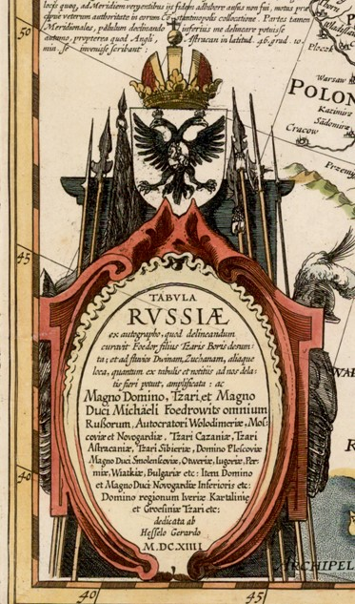
My Favorite Map: The Gerritsz/Blaeu 1614 Map of Russia
By Lorraine Sherry
Rocky Mountain Map Society
Notes:
Blaeu Russia Presentation - Lorraine
Introduction: quick video of Lorraine
Hi everyone. I’m Lorraine Sherry, presenting my Willem Blaeu map of Russia. I bought it from Barry Ruderman at an RMMS map fair more than ten years ago. Why? Because as a 3rd generation Lithuanian-American, I wanted to know where my ancestors came from.
First Slide – Title slide with cartouche
The map is gorgeous – with a beautiful cartouche, sketches of local people, an inset map of the City of Moscow, and the watershed of the Volga River all drawn in minute detail.
The engraver (Hessel Gerritsz) dedicated the map to Tzar Michael Romanov on being crowned Tzar of All the Russias in 1614.
Next slide 2: Publisher [Blaeu map]

Slide 2
Hessel Gerritsz engraved the map of Russia in 1614. Willem Blaeu published it in Amsterdam, in several editions of his Atlas Major. My map dates from the 1664 edition.
Notes:
Slide 2 – Publisher [Blaeu map]
Willem Blaeu was one of the foremost publishers of maps and atlases in Amsterdam, during what we term “the Golden Age of Dutch Cartography.” My copy of the Russia map was published by Blaeu in his “Atlas Major,” 1664 edition.
The engraver was Hessel Gerritsz, who was considered one of the chief Dutch cartographers of the 17th century. He started out as an apprentice to Willem Blaeu. Many of his maps wound up in atlases published by Blaeu, Jansson, and others.
Gerritsz is the same engraver who created the 1613 Lithuania map for Prince Nicholas Radziwill, then ruler of Lithuania. Same Radziwill family as Jackie Kennedy’s brother-in-law. My friend Andrew Kapochunas from NY Map Society owns a copy of the Gerritsz Lithuania map. It’s very rare.
Next slide 3: Cartouche [inscription]

Slide 3
Map Cartouche (in Latin)
“This map of Russia is drawn according to Foedor, son of Tzar Boris [Godunov], bordered by the river Dvina and other places as shown, as much as possible, and increased by the Great Lord, Tzar and Grand Duke Michael Foedrowits of all the Russias, ruler of Vladimir, Moscow and Novgorod, Tzar of Kazan, Astrakhan, Siberia, and Plescovia, Grand Duke of Smolensk […and other places], Bulgaria, upper and lower Novgorod, extending to Grozny, etc.”
“Dedicated by Hessel Gerritsz in 1614.”
Notes:
Slide 3 – Cartouche [inscription]
Let’s start with the cartouche inscription on the Russia map, roughly translated from Latin. It’s LONG!!
What does the “Tzar of All the Russias” mean? It’s complicated. Isn’t Russia a nation? It wasn’t always one. It started with several major Viking settlements and “Rus Lands.”
In the 800’s, when Rurik the Viking was plying his trade on the ancient Amber Route between the Baltics and Constantinople, what is now Russia was just a collection of warring Slavic tribes. The Vikings founded Novgorod, south of Lake Ladoga, in 854.
There were two major Viking trade routes: the northern route (following the Dnieper River route through Russia) and the southern route (following the Dniester River route through Ukraine).
The winding, northern trade route went from the Gulf of Finland => Novgorod => Kiev => Dnieper River => Black Sea => Constantinople.
Next slide 4: Viking trade routes [Internet map]

Slide 4
Viking Trade Routes in the 800s
(simplistic map!!)
Novgorod and Kiev to Black Sea via Dnieper River System
Notes:
Slide 4 – Viking trade routes [Internet map]
To protect his cargo, Rurik the Viking negotiated with the tribal leaders along the Dnieper River to unite the local tribes under his protection, and then founded Kiev in 882. This tribal confederation was known as “The Rus.”
Later, Rurik’s descendants declared themselves princes, like Prince Igor. They expanded their territories southward from Novgorod to Kiev, and inland to Vladimir in Suzdal Province in 990. The Rurik Dynasty continued until 1584 when Ivan the Terrible died of a stroke.
This Viking trade routes map from Novgorod => Kiev => Black Sea is a good way to orient ourselves on the Blaeu map. But where’s Moscow?
Founded in 1147, Moscow was just a little fortified town near the trading town of Vladimir. It gained power in the 1300s under the Muscovite rulers. Meanwhile, Kiev became the capital of Ukraine and flourished with the Dnieper River trade.
Next slide 5: All the Russias [main cities]

Slide 5
Novgorod – founded in 854 (south of Lake Ladoga)
Vladimir – founded in 990 (east of Moscow)
Moscow - founded in 1147 (center of the map)
Kiev, Ukraine – founded in 882 (on the Dnieper River)
Notes:
Slide 5 – All the Russias [main cities]
The Blaeu map cartouche refers to the Grand Duke of Moscow, Michael Romanov, as “Great Lord, Grand Duke, and Tzar of All the Russias, ruler of Vladimir, Moscow and Novgorod, etc. etc.” So, what are “all the Russias?” There are 3:
Russia Proper (Great Russia) = the core of old Russia;
Malen’kiy Rus’ (Little Russia) = mostly Ukraine;
Belaya Rus’ (White Russia) = the eastern half of modern Belarus.
The hereditary title of Tzar (from the Roman “Caesar”) was created in 988 when Prince Vladimir of Kiev married Anna, sister of the last Byzantine Emperor Basil II; took Basil’s credentials as the Eastern Roman Emperor; and Christianized Russia.
In the 16th century, the last Rurik Tzar, Ivan the Terrible, Grand Prince of Moscow, murdered most of his family including the crown prince, told his 8 wives to “get thee to a nunnery,” and died of a stroke in 1584. The royal succession was worse than Godfather Part I.
Next slide 6: Portraits of three Tzars

Slide 6
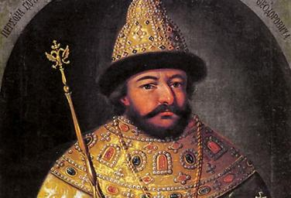
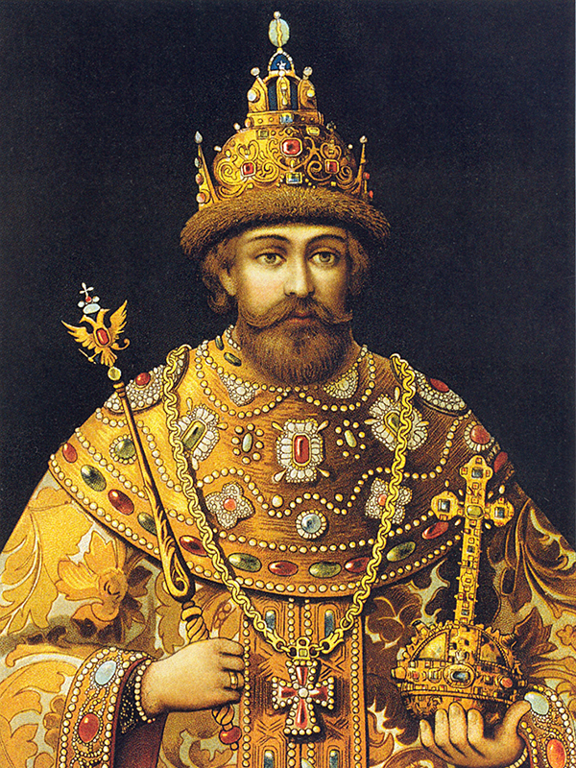
The 3 Tzars – 1584 to 1614
Tzar Ivan IV – Last of the Ruriks, AKA Ivan the Terrible
Tzar Boris Godunov, Regent for Ivan’s sons, Fyodor and Dmitri
Tzar Mikhail Romanov, started a new dynasty
Notes:
Slide 6: Portraits of three Tzars
In the Blaeu map cartouche, Hessel Gerritsz mentions 3 Tzars – handsome dudes, aren’t they? His cartouche marks the following events:
the end of the 700-year old Rurik dynasty with Ivan the Terrible,
the “Time of Troubles” under Boris Godunov,
and the beginning of a new Dynasty with Michael Romanov – which lasted until 1917.
The story belongs in the tabloids. Mussorgsky’s opera “Boris Godunov” only tells part of the tale. And the Lithuanians were definitely involved.
Ivan the Terrible had two remaining heirs – his autistic son Fyodor, and Dmitri, the son of his 8th wife, the last of the Ruriks. Fyodor’s regent, Boris Godunov, was elected the next tzar, and thus began the Time of Troubles for Russia. Famine, poverty, and anarchy. To add to the chaos, two imposters from neighboring Lithuania arrived on the scene, each pretending to be Dmitri, true heir to the throne.
Next slide 7: Boris Godunov [Uglich photo]

Slide 7
In 1591, someone put a hit on Ivan IV’s 8-year-old son Dmitri (the last Rurik) at this monastery in Uglich. Whodunit? Watch the opera…
Notes:
Slide 7 – Boris Godunov [Uglich photo]
Where was the real Dmitri? Considered illegitimate by the Orthodox Church, the boy was exiled to the little town of Uglich, and murdered there in 1591.
Think like Godfather Parts II and III: “I wasn’t there, so I couldn’t have done it.” The people were furious! After Boris Godunov died in April 1605 while playing chess, the anti-Godunov boyars murdered his entire family in June, as a vendetta. Things got worse.
Next slide 8: Moscow Kremlin [photo]

Slide 8
Moscow Kremlin 400 years after the Blaeu map
Notes:
Slide 8 – Moscow Kremlin [photo]
In 1613, the Russian parliament, known as the Zemsky Sobor, took charge and elected Mikhail Fyodorovich Romanov, Grand Duke of Moscow, as the next Tzar. Michael was grand-nephew of Ivan’s 1st wife, Anastasia Romanov, and his father was Patriarch of Moscow. He united the boyars, started a new dynasty, and conquered most of Siberia.
As Tzar of All the Russias, Michael Romanov ruled from the Moscow Kremlin. In Russian, a “kremlin” just means a citadel or castle within a city or town.
The City of Moscow has huge stone walls with towers that encircle the Kremlin, Red Square, St. Basil’s, a park, royal buildings and churches, three bridges, and military encampments. It’s an impressive city now. But what was it like in Michael Romanov’s time?
Next slide 9: Moscow city plan [inset map]

Slide 9
Kremlin
Military
Neglina River bridge, fortress
Moscow River bridge
Kitay-gorod (merchants)
Urban center
Religious Center
Notes:
Slide 9 – Moscow city plan [inset map]
The city of Moscow is located in the watershed of the Volga River, on a cliff overlooking the Moscow river. A map of Moscow appears in the upper left corner of the Blaeu map.
It is a copy from the 1572-1617 print collection, “Civitates Orbis Terrarum,” (Cities of the World) by Braun and Hogenberg. This inset is the Moscow Map’s first appearance in print. It has been copied by many other 17th century cartographers, including John Speed.
The engraving is meticulous – you need a magnifying glass to see the details. A tourist map might help, but thankfully, Braun & Hogenberg included a place list. I marked the main places.
Finally, the brand new Tzar needed to know the boundaries and extent of his empire. Did he commission the map? Who did the survey? Was it just another map in Blaeu’s atlas? We’ll never know. But it took me 3 days to figure out the boundaries!
Last slide 10: Russia’s Boundaries [map]

Slide 10
Russian Boundaries
North: Sweden and Karelia (Finland), Livonia (Dvina River)
East: Ivan IV added Kazan and Astrakhan (on Volga River); Ural Mountains further east
West: Dnieper River – Lithuania and Ukraine
South: Crimea – This stockade was meant “to keep the Crimeans out”
Notes:
Last slide 10 – Russia’s Boundaries [map]
Michael Romanov was the “Great Lord, Tzar of All the Russias” and so forth. But the cartouche also names him, “Tzar of Kazan, Astrakhan, Siberia, etc.” - Eastern territories conquered by Ivan the Terrible. Thus, in 1614, natural boundaries of Russia were:
North: Swedish and Finnish territories including Karelia; Sea of Murmansk
East: Volga River to the Caspian Sea
West: Dvina River (border with Livonia – now Estonia and Latvia); Dnieper River (border with Lithuania and Ukraine)
South: Don River; and a stockade. The Latin inscription says “Tzar Fyodor Ivanovich built this wall to keep the Crimean Tatars out” – but I think Boris had it built and just used Fyodor’s name.
During Michael’s reign, Russia kept acquiring new lands, by treaty, war, or invasion. By the time he died, Russia stretched all the way to the Pacific Ocean. And the rest is history.
THE END!

